Slide 1
Cloud Security & Forensics
Submitted by
Christo james
M.Sc. Cyber Security

Slide 2
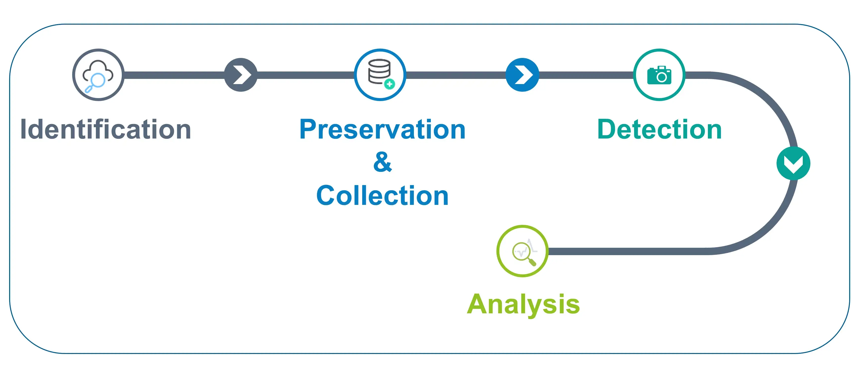
What is Cloud Forensics?
Cloud Forensics is actually an application within Digital Forensics which oversees the crime committed over the cloud and investigates on it. Cloud computing is based on huge network, which spreads globally. Hence, Cloud Forensics is said to be a subset of Network Forensics. The basic technique still remains as the forensic investigation of network.

Slide 3
Usages of cloud forensics
Investigating cyber crimes:
Cloud forensics can be used to investigate cyber crimes such as data breaches, cyber extortion, and cyberbullying. For example, if a company suspects that its cloud-based data has been accessed or stolen by an unauthorized party, it can use cloud forensics to track the source of the breach and determine the extent of the damage.
Supporting legal proceedings:
Cloud forensics can also be used to gather evidence for legal proceedings, such as civil or criminal cases. For example, if a company is involved in a lawsuit and needs to produce evidence to support its case, it can use cloud forensics to retrieve and analyze relevant data from the cloud.

Slide 4
Analyzing employee misconduct:
If an employer suspects that an employee has been using cloud-based resources for inappropriate or unauthorized purposes, they may engage cloud forensic experts to conduct an investigation. The experts would collect and analyze forensic evidence from the cloud environment to determine the extent of the misconduct and identify any relevant suspects.
Preventing cyber crimes:
In addition to investigating and supporting legal proceedings, cloud forensics can also be used to prevent cyber crimes. For example, a company can use cloud forensics to identify vulnerabilities in its cloud infrastructure and take measures to secure it.

Slide 5
Assessing compliance:
Companies may also engage cloud forensic experts to conduct audits of their cloud environments to ensure that they are compliant with relevant laws and regulations. The experts would collect and analyze forensic evidence from the cloud environment to identify any potential non-compliance issues and recommend remediation steps.
Overall, cloud forensics is a crucial tool for organizations that rely on cloud computing to store and manage their data, as it helps them to protect their assets, ensure compliance, and prevent or investigate cyber crimes.

Slide 6
Thank you

